Slide 1
Gamify
But Use Your Powers for Good Not Evil
Valary Oleinik
valary.oleinik@weil.com

Slide 2
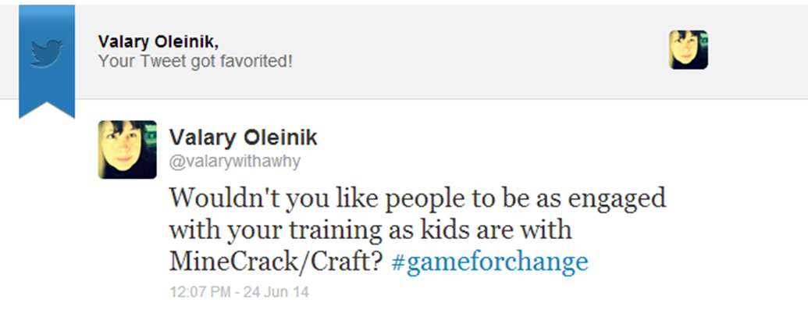
http://about.me/valary

Slide 3
“ Gamification is using game-based mechanics, aesthetics and game thinking to engage people, motivate action, promote learning, and solve problems.”
http://karlkapp.com/books/

Slide 4
http://meetingchange.wordpress.com/2013/01/23/gamification-framework-for-meetings/

Slide 5
“If a business can identify the goals it shares with its audience or provides its audience with goals that are meaningful to them….”
http://www.gartner.com/it/products/research/media_products/gamify/index.jsp

Slide 7
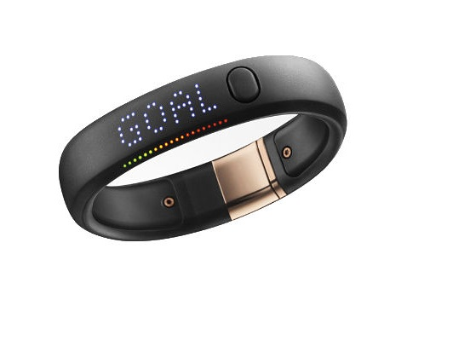
Nike+ FuelBand launches in 2012
Within 2 years, over 400 billion points earned; equivalent of 44 million marathons

Slide 8
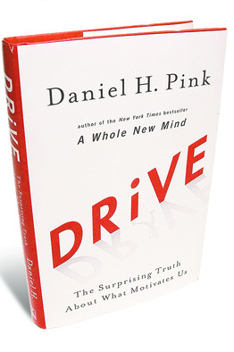
“When money is used as an external reward … the subjects lose intrinsic interest … can reduce a person’s longer-term motivation….”
http://www.danpink.com/books/drive

Slide 9
Like caffeine, extrinsic wears off

Slide 10
Motivated, Productive and Happy
Autonomy
Mastery
Purpose
Connected

Slide 11
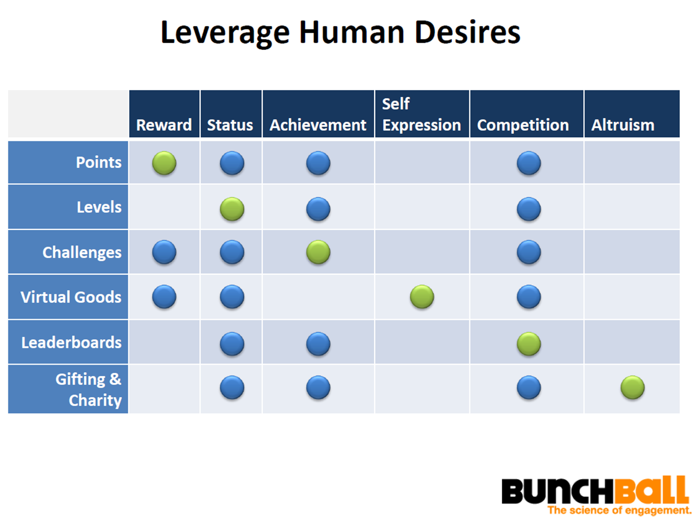
http://www.bunchball.com/resources

Slide 12
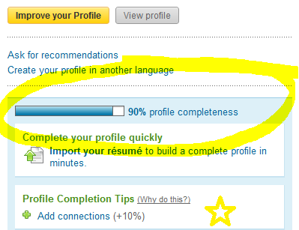
LinkedIn Is Gamified?

Slide 13
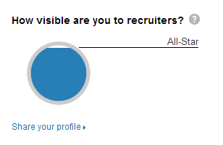
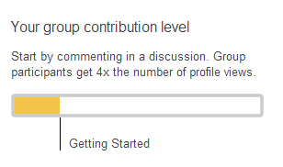

Slide 14
gamification.co
http://www.gamification.co/

Slide 15
Peer Appreciation Game from DueProps
https://dueprops.com/

Slide 16
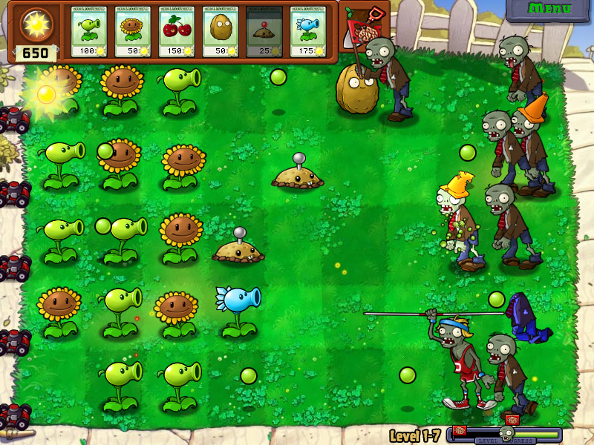
Play to learn … and have fun

Slide 17
Microsoft Word Training
X

Slide 18
2
1
3
5
4
6
8
9
7
10

Slide 19
Phone Training
O
X
X

Slide 20
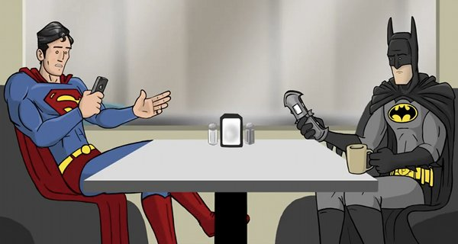

Slide 21
LMS Training
O
X
O
X
X

Slide 22
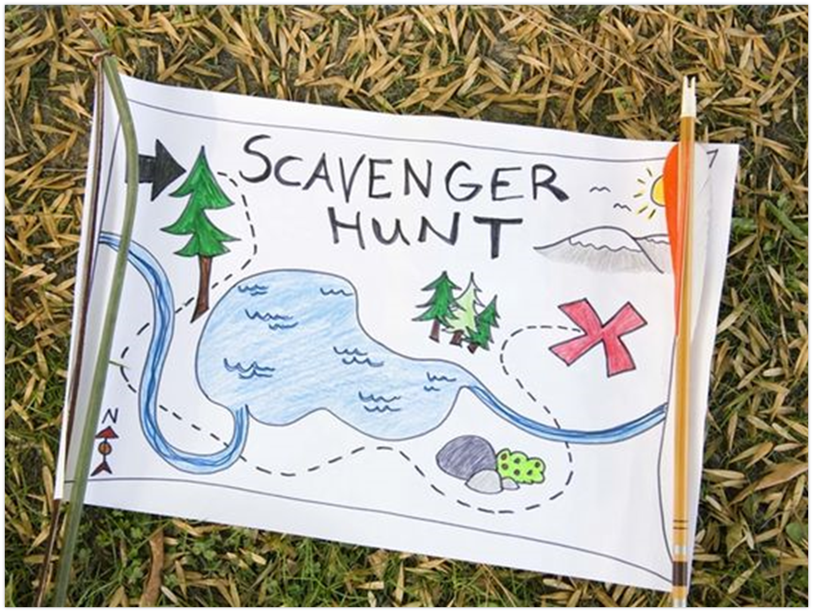
Search events
Register for class
Access knowledge bank
Launch modules
View transcript

Slide 23
Customer Service Training
X
O
X
O
X
O
X

Slide 24
Exploring Our Customer Service Universe: Moving Beyond Expectations

Slide 25
Player Engagement Model
Collaborative
Intrinsic
Multiplayer
Campaign
Emergent
Competitive
Extrinsic
Solitary
Endless
Scripted

Slide 26
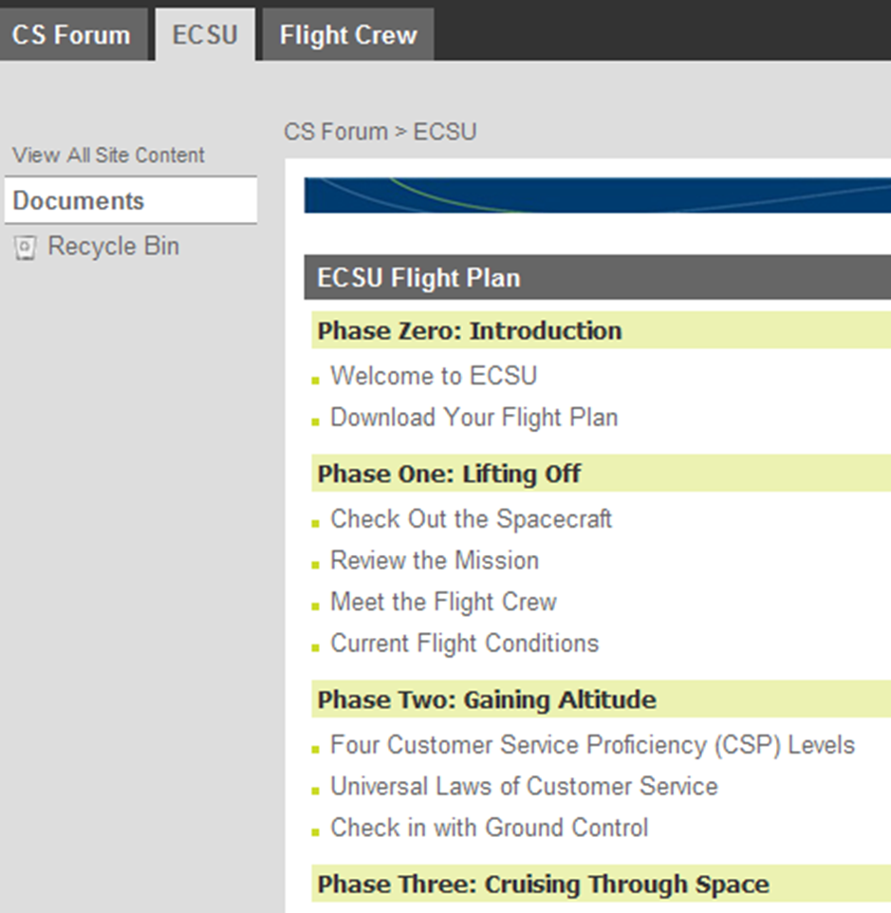

Slide 27
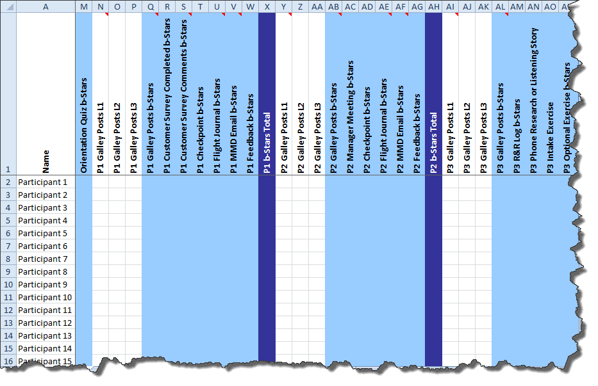
Leaderboard
Discussion Posts
Completed Activities
Make My Day emails

Slide 28
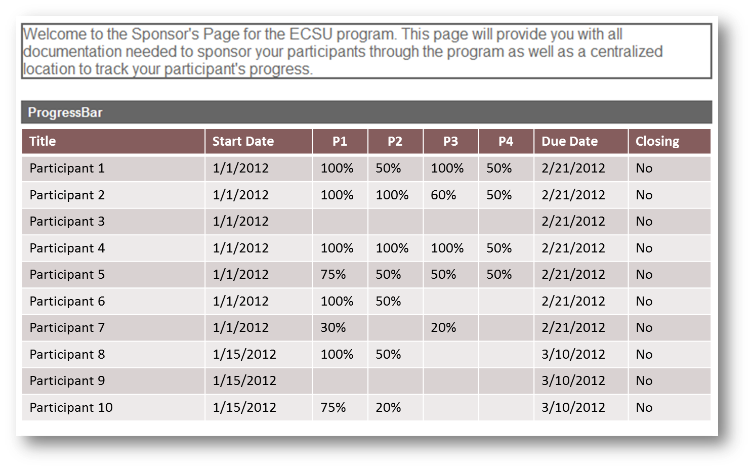
Sponsor Progress Page

Slide 29
5 Takeaways
Know your goals
Know your audience
Add value not work
Start small
Have fun

Slide 30
So What Do You Think?
Valary A Oleinik
valary.oleinik@weil.com

